Slide 1


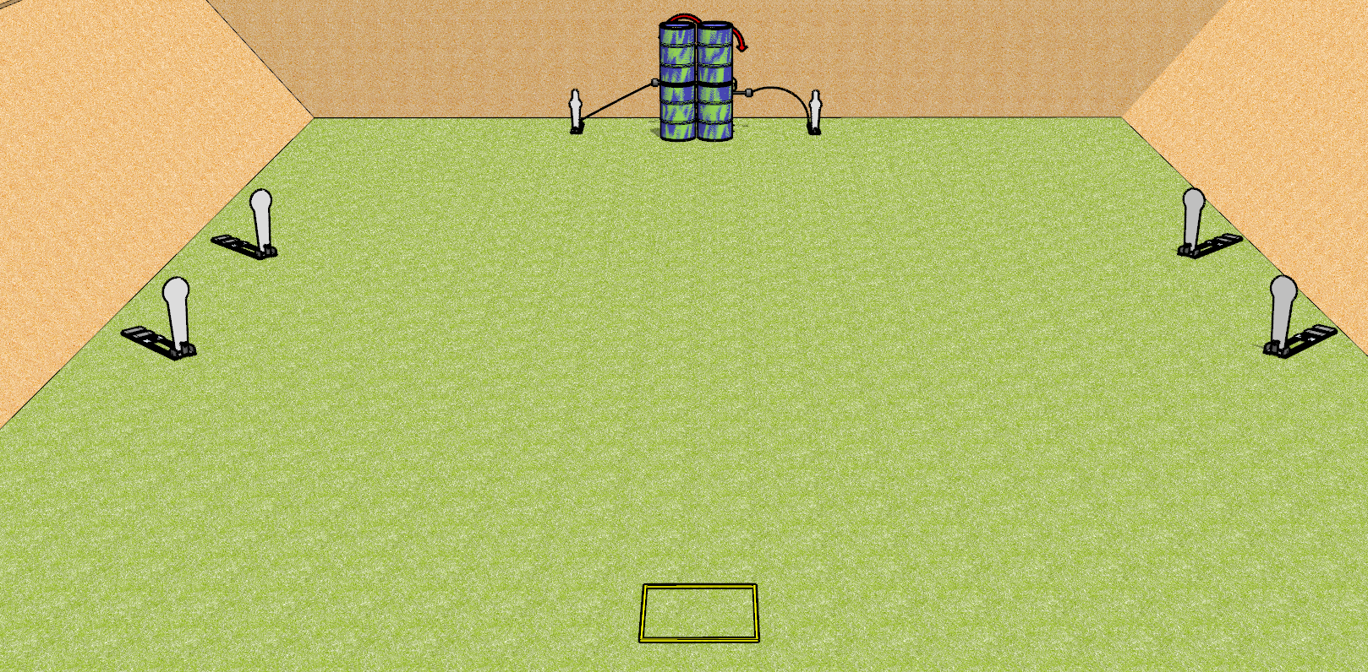
 | Dothan Gun Club – USPSA Match “Speed” shoot Course Designer : Drew Coleman
Round Count 8 rounds 2 IPSC targets 4 colt poppers, 2 USPSA mini poppers
Equipment List 2 swingers + activators Shooting box

Slide 2
“Speed” Shoot
Written Stage Briefing
“Speed” Shoot is an 8 round, 40 point, Comstock speed shoot. There are 2 IPSC targets, 4 colt poppers, and 2 USPSA mini poppers. The best 1 hit on paper will score, and steel must fall to score. The start signal is audible.
The left swinger is activated by the left mini popper, and the right swinger is activated by the right mini popper. Please check the activators prior to walkthrough and set them the same way every time.
Handgun start position is in shooting box, wrists below belt. Handgun is loaded and holstered.
PCC start position is in shooting box. Loaded carbine is held with both hands, stock on belt, safety on.
On start signal, engage targets as they become available from within the shooting area.

Slide 3
 | Dothan Gun Club – USPSA Match “Speed” shoot Course Designer : Drew Coleman
Round Count 10 rounds 2 IPSC targets 4 colt poppers, 2 USPSA mini poppers
Equipment List 2 swingers + activators Shooting box

Slide 4
“Speed” Shoot
Written Stage Briefing
“Speed” Shoot is an 10 round, 50 point, Comstock speed shoot. There are 2 IPSC targets, 4 colt poppers, and 2 USPSA mini poppers. The best 2 hits on paper will score, and steel must fall to score. The start signal is audible.
The left swinger is activated by the left mini popper, and the right swinger is activated by the right mini popper. Please check the activators prior to walkthrough and set them the same way every time.
Handgun start position is in shooting box, wrists below belt. Handgun is loaded and holstered.
PCC start position is in shooting box. Loaded carbine is held with both hands, stock on belt, safety on.
On start signal, engage the colt poppers or the mini poppers, then perform a mandatory reload and engage the remaining array. The paper may be engaged at any time.

